Slide 1

SUBJECT:
BLOOD CELL DETECTION
Instructor: | Dr. Nguyen Viet Dung
Team members: Class: | Đỗ Thị Minh Phương | 20193275
 | Nguyễn Viết Long | 20193269
 | Đoàn Thị Ánh Ngọc CTTT Y Sinh K64 | 20193273
04/2022

Slide 2

CONTENT
1
OVERVIEW
2
THEORY
3
METHOD

Slide 3
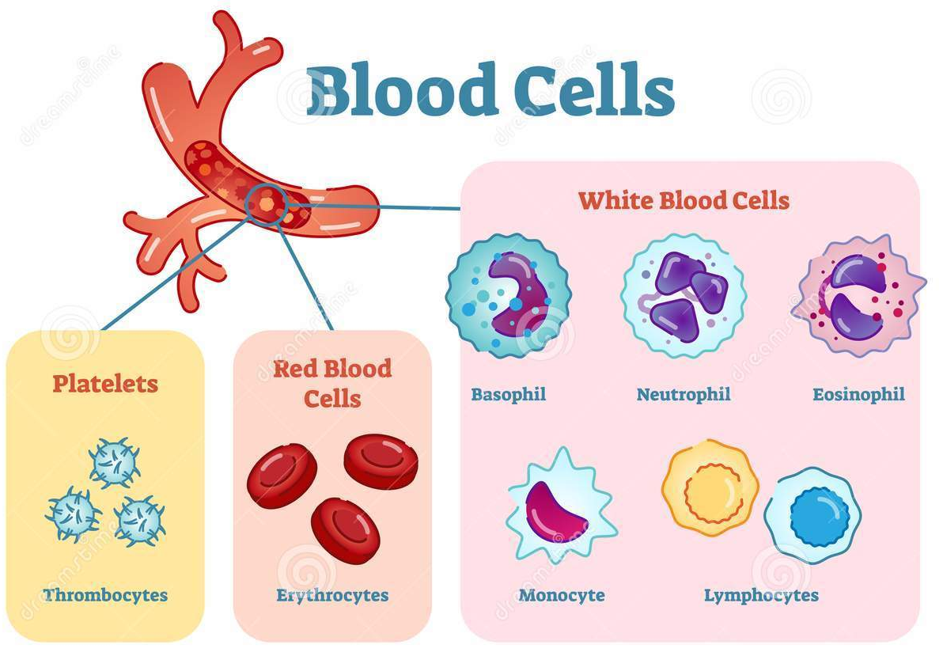
1. OVERVIEW
Complete Blood Cell Count (CBC): a medical test providing information on cells in human’s blood ​
00- Red blood cells/Erythrocytes: Normal range: 40-45%, 4.7-6.2 million cells/microliter​
000⇒ High: Polycythemia,… ​
000 Low: Anemia,…​
00- White blood cells/Leukocytes: Normal range: 1%, 4500-11000 cells/microliter​
000⇒ High: Leukemia,… ​
000 Low: Neutropenia,…​
00- Platelets/Thrombocytes: Normal range: 15-35%, 150000-4500000 cells/microliter​
000⇒ High: Thrombocythemia ,… ​
000 Low: Thrombocytopenia,…

Slide 4
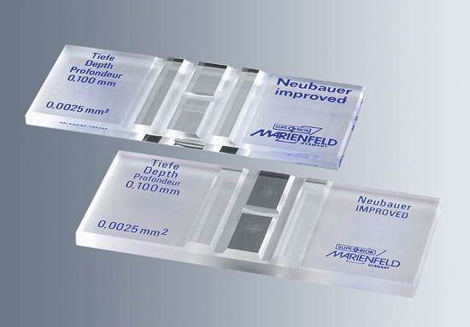
1. OVERVIEW
Traditional method: Manually counting blood cells using haemocytometer and other equipments
⇒ Expensive and time-consuming

Slide 5
1. OVERVIEW
RELATED WORKS:
Image processing technique: raspberry-pi based image analysis system to segment and count blood cells using Hue, Saturation, and Value (HSV) thresholding method
Machine learning technique
Versions of YOLO algorithm, SSD,...
Single-stage Detection
Object detection
R-CNN, Fast R-CNN, Faster R-CNN,…
Two-stage Detection

Slide 6
1. OVERVIEW
RELATE WORKS:
Easy Install
Intuitive Layout
=> Choose YOLOv5 to do the project
Fast Training
YOLOv5
Inference Ports that work
Easy Translation to Mobile

Slide 7
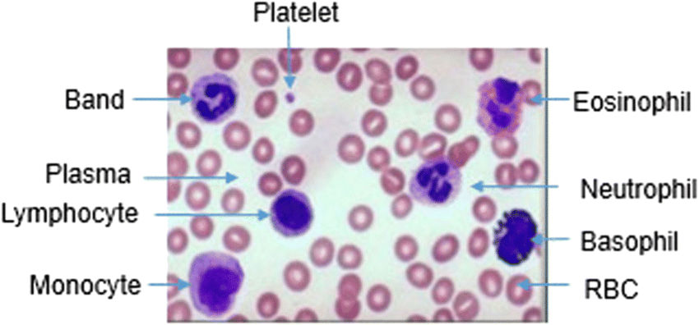
=> METHOD
1. OVERVIEW
Using object detection and classification algorithm to detect and count blood cells directly from microscopic blood smear images

Slide 8
1. OVERVIEW
Objectives and tasks:
Now:
Collect image dataset.
Train the YOLOv5 model to recognize three types of blood cell on the images.
Evaluate and improve the results.
In the future:
Train the YOLOv5 model to recognize 5 types of white blood cell.

Slide 9
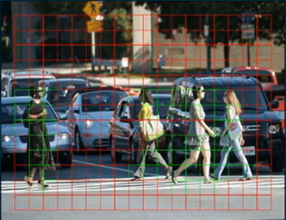

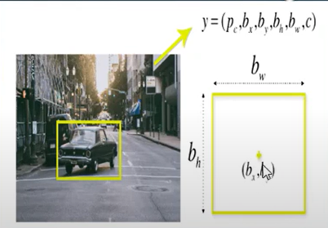
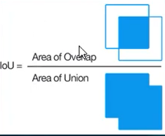
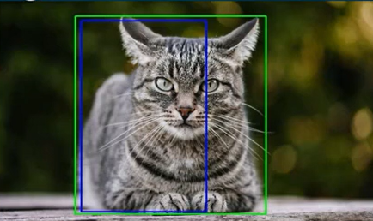
2. THEORY
Residual blocks
YOLO'S ALGORITHM
Bounding box regression
Intersection over union (IOU)

Slide 10
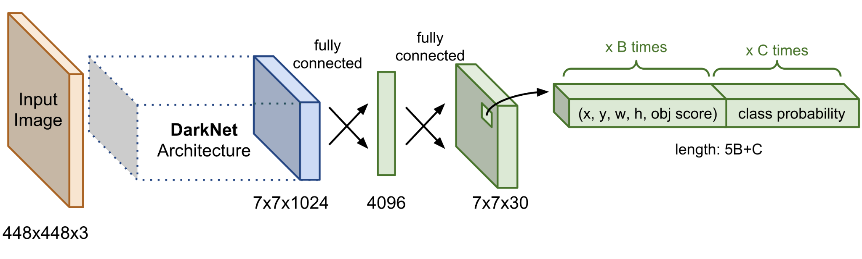
2. THEORY
Network architecture of YOLO
Include two components:
Base Network: a CNN architecture (DarkNet) is used as a feature extractor.
Extra Layers: Predict bounding box and class probability in feature map.

Slide 11
2. THEORY
Execution steps:
Feature Extractor: Resize input image into 448x448x3 and then forwarding through a base network (DarkNet) to archive these good features. Output is a final feature map (for example 7x7x1024).
Anchor Box Regressor: Each pixel in output feature map will be regressed B anchor boxes coordinator and class probability.
Non Max Suppression (NMS): Suppress bounding boxes which are overlapping with other boxes in order to get an unique bounding box for each object.

Slide 12
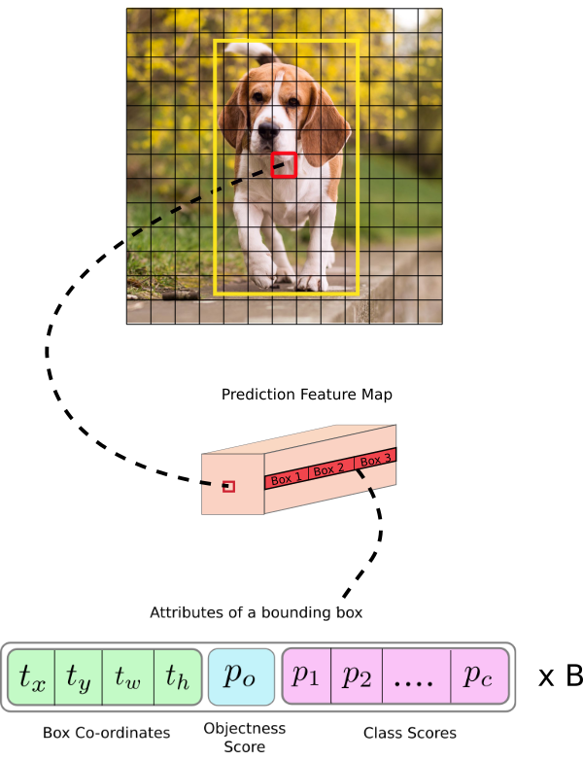
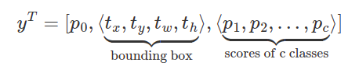
2. THEORY
Bounding box and class probability
y output of relevant bounding box includes:
probability of existing object (p0)
bounding box coordinator (tx, ty, tw, th)
scores of C classes (p1, p2,..., pc)
⇒ Output shape: 5 + C.
Unify predict bounding box and class probability simultaneously.
If we detect B bounding boxes per pixel:
4B coordinator + 1B existing object probability for each bounding boxes
C classes probability for each pixel.
⇒ Output shape (5B + C)
5 elements

Slide 13
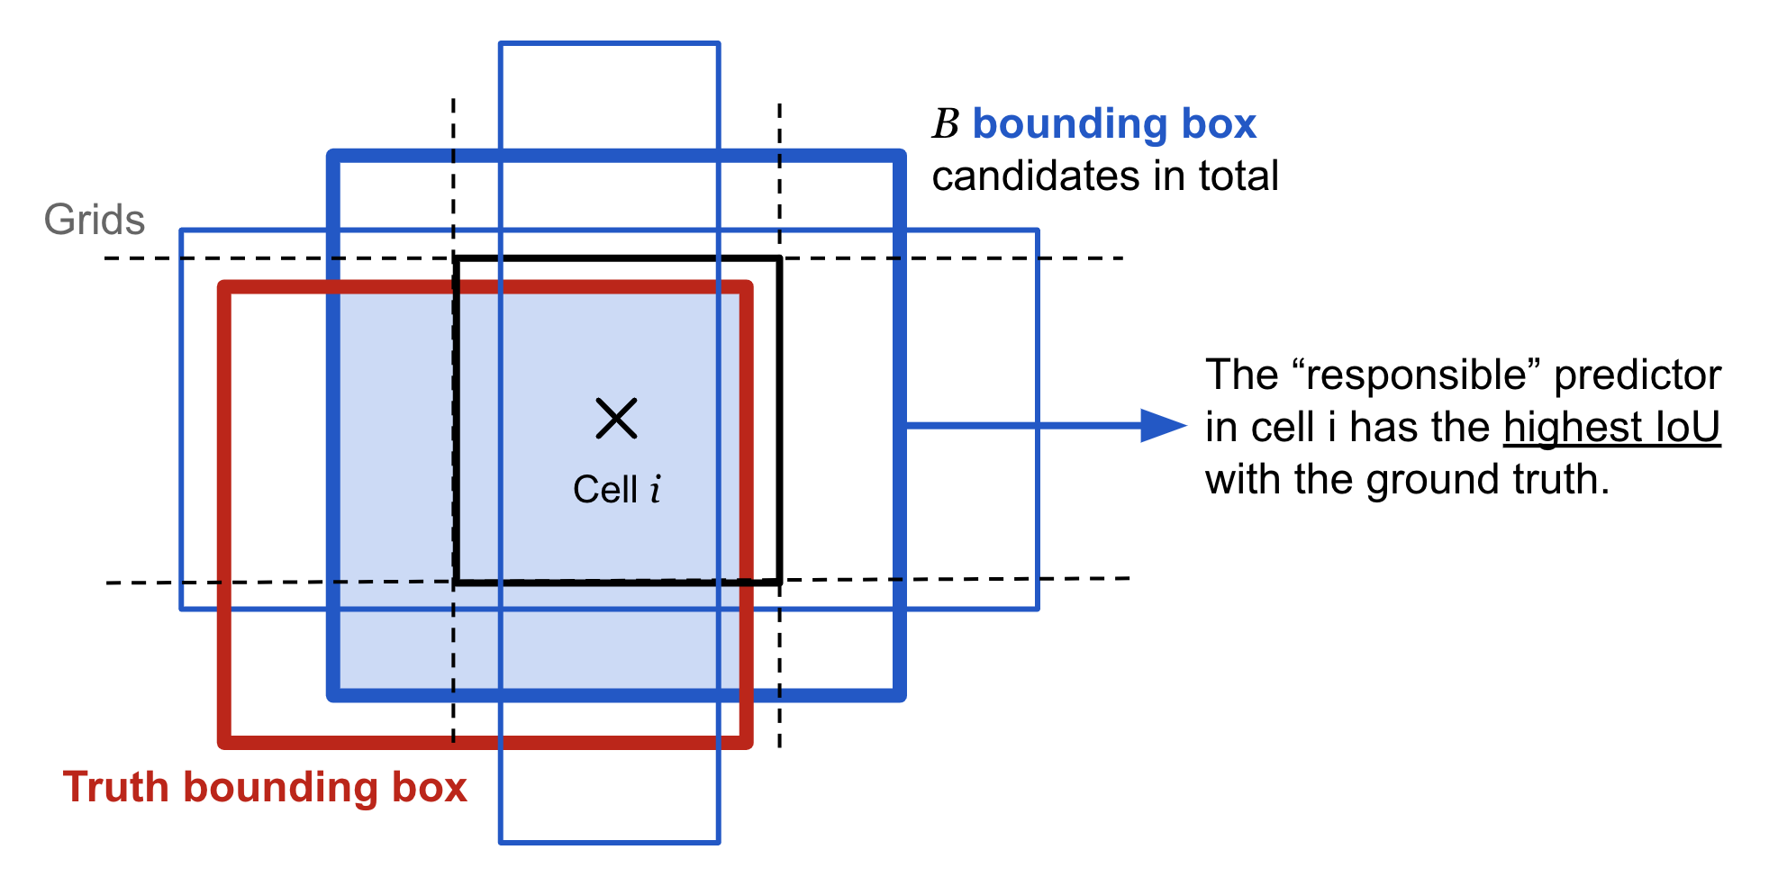
2. THEORY
Anchor based regression
Each object is assigned to a cell i which has the center point falls inside this cell.
pre-define B anchor boxes on cell i in order to facilitate regression ground truth bounding box.
Select only an anchor box with highest IoU with the ground truth box as a responsible predictor.
⇒ Require the a center point and a responsible anchor box for predicting bounding box.

Slide 14
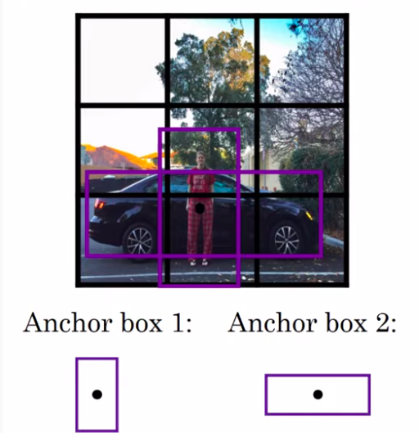
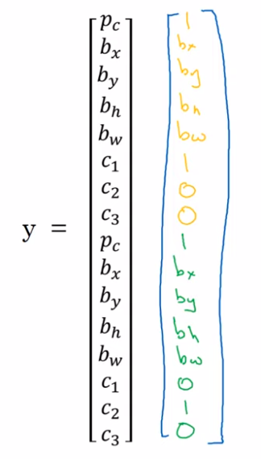
2. THEORY
Anchor based regression
Each object is assigned to a cell i which has the center point falls inside this cell.
pre-define B anchor boxes on cell i in order to facilitate regression ground truth bounding box.
Select only an anchor box with highest IoU with the ground truth box as a responsible predictor.
⇒ Require the a center point and a responsible anchor box for predicting bounding box.
Hard cases:
Many objects have the same middle points
⇒ Create two output for each anchor boxes

Slide 15
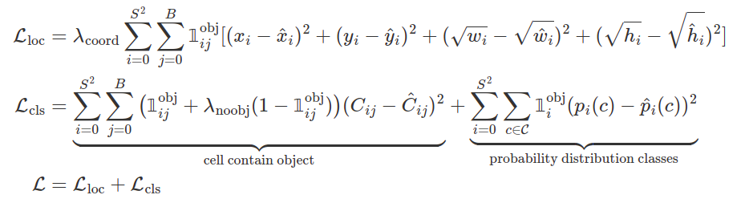
2. THEORY
Loss function: simultaneously combine localization loss and classification loss
localization loss: predict coordinator bounding box
classification loss: predict if the cell contain object and the class probability if exists object.

Slide 16
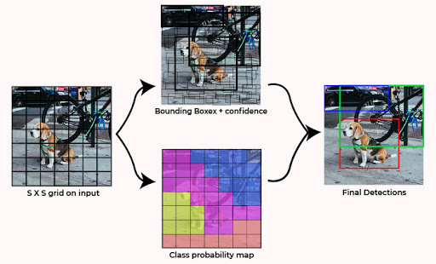
2. THEORY
Class probability of bounding box at test time:
At test time class probability score is a multiplication of probability of object x probability of classes x IoU(ground truth, prediction box)

Slide 17
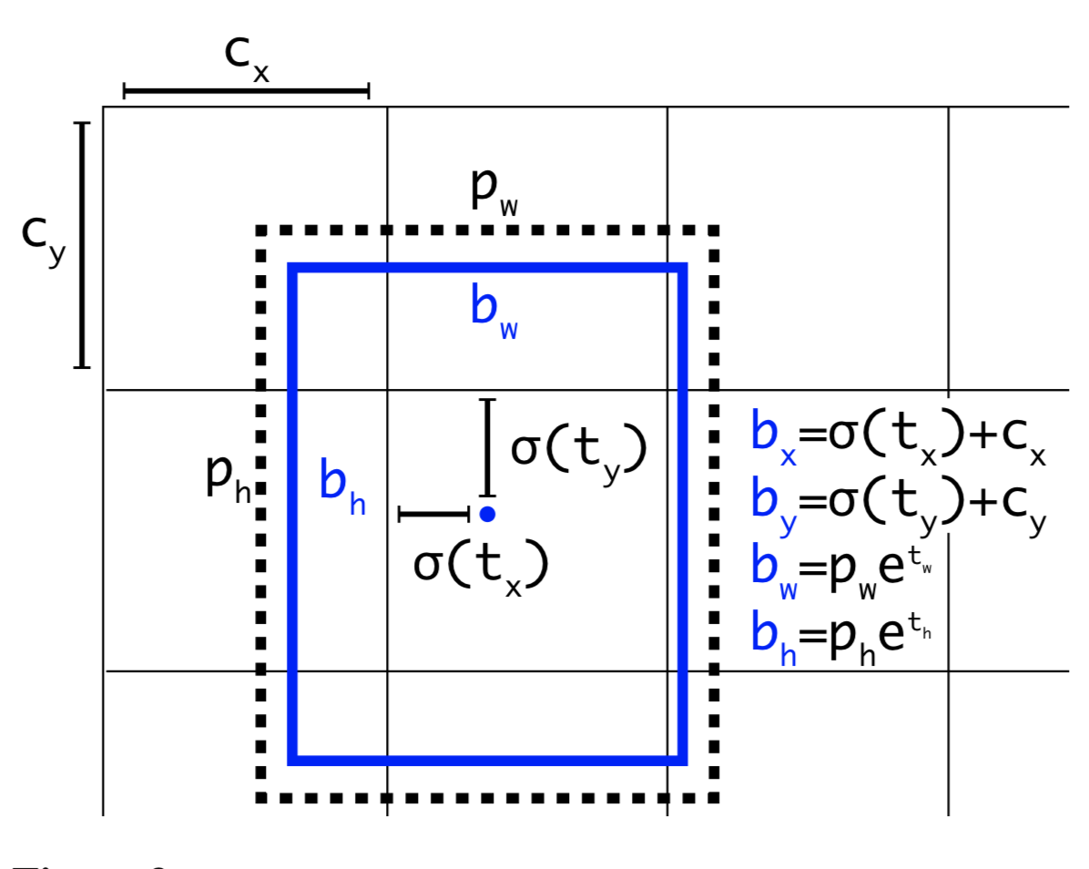
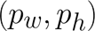
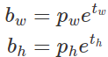
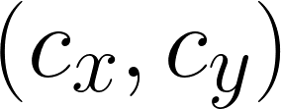
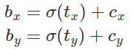
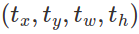
2. THEORY
Transformation coordinator:
YOLOv2 and YOLOv3: The direct coordinator is transformed on cell i and Anchor Boxes according to exponential and translation
is anchor box (with, height) that can transform to prediction bounding box
is top-left position of cell to transform top-left prediction bounding box
⇒ is transform value of prediction bounding box which are
small and easy to train. From those values can predict (bx, by, bw, bh).

Slide 18
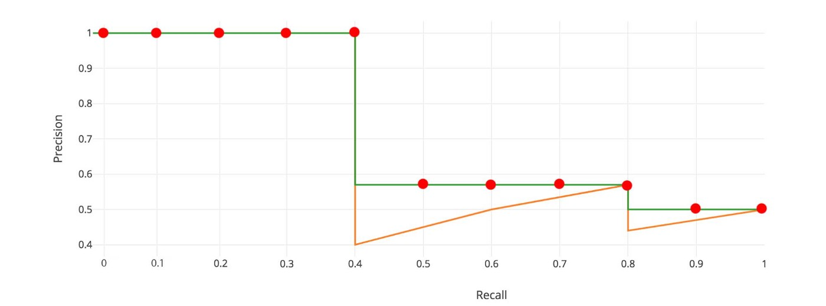
2. THEORY
Evaluate the model:
Intersection over Union (IoU)
Evaluation Metrics:
Precision and Recall
mean Average Precison ( mAP )

Slide 19
3. METHOD
Using YOLOv5 algorithm to build a deep learning model for detecting and counting blood cells directly from microscopic blood smear images
Dataset
Image Pre-processing & Labelling
Training Blood cells Detection Algorithm
Training Model
Output
Identification & Counting
Trained Model

Slide 20
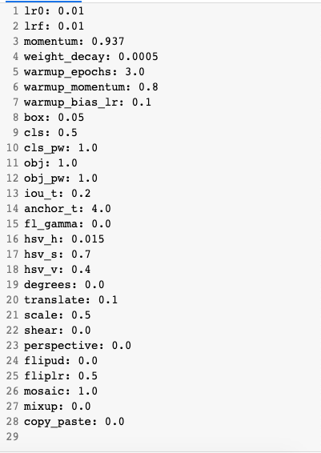
4. METHOD FOR IMPROVING MODEL PERFORMACE
Method:
Tuning model’s structure
Changing model’s hyperparameter:
Learning rate
IoU
Weight decay

Slide 21

IMPROVING SMALL OBJECT DETECTION IN YOLOV5
Instructor : Dr. Nguyen Viet Dung Team members : Doan Ngoc Minh Phuong Viet Long

Slide 22
METHOD
- ResNet - DenseNet …
Backbone
- Pan-Net - FPN -biFPN …
Replacing certain structural elements of the model
Neck
- The sizes of anchor boxes - Learning rate - Deep & Wide …
Other modifications

Slide 23
PURPOSE
Investigating the effects and rationale of different architectural and model alterations applied to YOLOv5 in order to improve its small-object detection abilities.

Slide 24
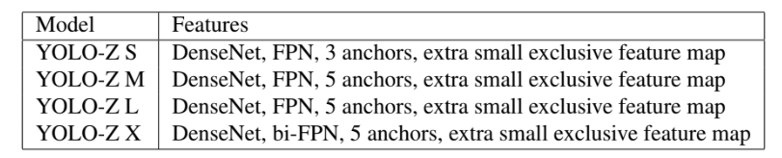
METHOD
Referring to this proposed family of models at different scales as YOLO-Z, short for ‘YOLO Zoomed’

Slide 25
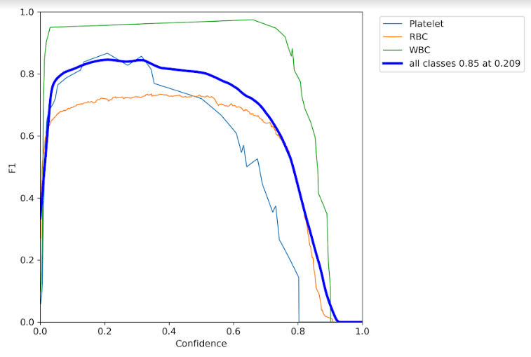
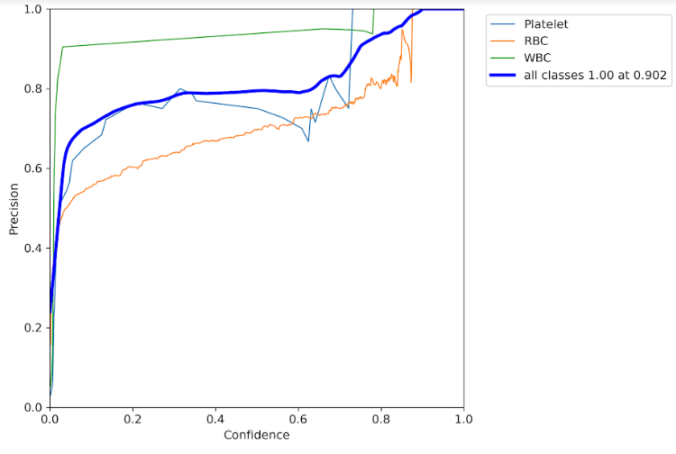
RESULT (FIRST)

Slide 26
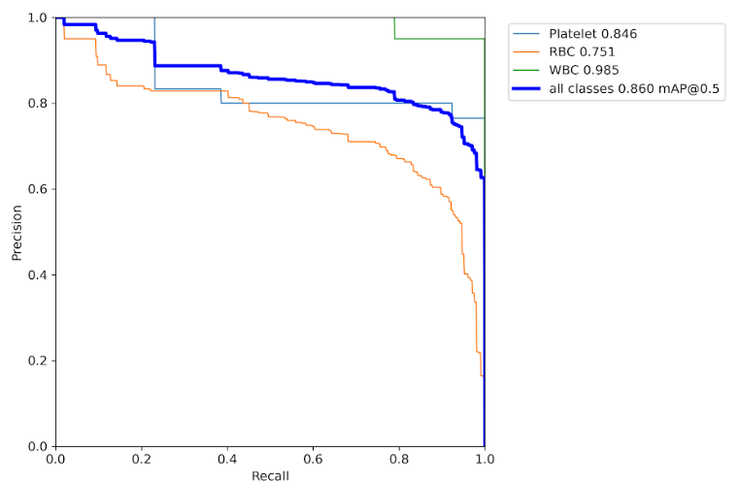
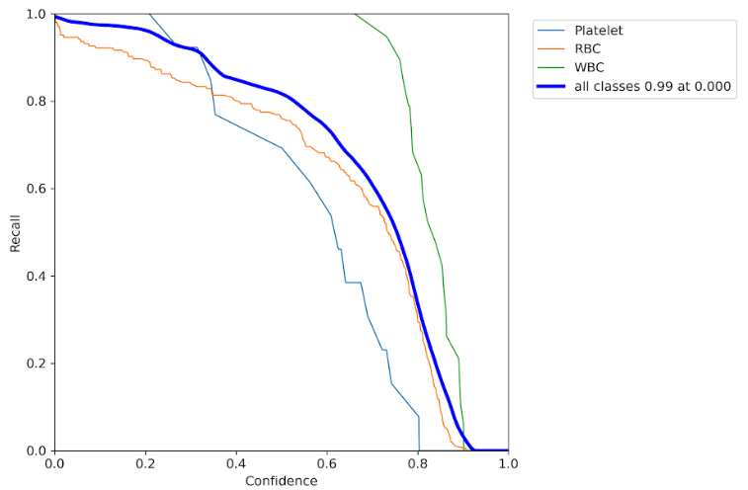
RESULT (FIRST)

Slide 27
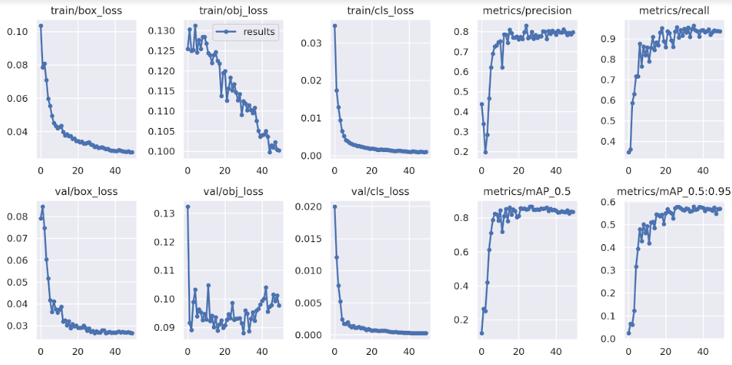
RESULT (FIRST)

Slide 28
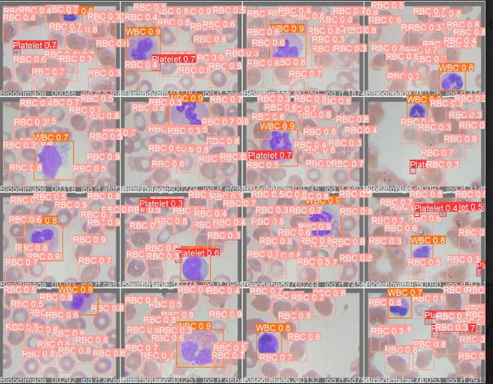
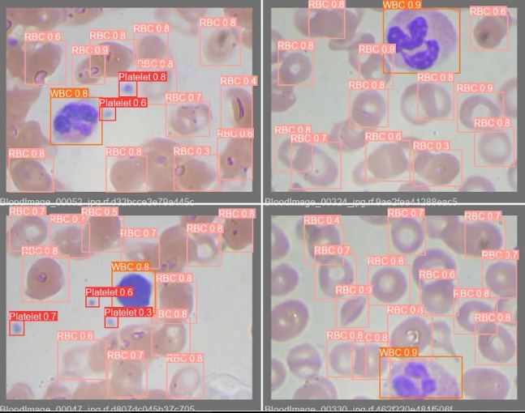
RESULT (FIRST)

Slide 29
THANK YOU !

